Slide 1
RNAseq for Nrf2 effect
Human/mouse control + knock out

Slide 2
Samples used in the analysis
Human samples:
Control: K70 (3 samples)
P10-treated: K70P10 (2 samples, sample#3 removed)
MD-treated: K70MD (3 samples)
Mouse samples:
SH (2 samples, sample#2 removed)
AG (2 samples, sample#2 removed)
MD-treated: K70MD (3 samples)
Purpose:
To validate P10 and MD as inhibitors of the NRF2 pathway in human ESCC cells
To find additional pathways affected by P10 and/or MD for future studies
To find differentially expressed genes and pathways due to AG treatment in mouse tissues

Slide 3
Bioinformatic analysis
Data QC
FastQC (v 0.11.5) for general QC metric
Unique alignment percentage assessment
Trim adapter (cutadapt v. 1.12, if applicable)
Alignment to the reference genome
Aligner STAR (v. 2.6.0c)
Human reference: (hg38)
Mouse reference: (mm10)
Quantification
FeatureCounts (v. 1.5.1)
DESeq2 (v 1.34.1) for DEG detection

Slide 4
Alignment evaluation – unique mapping %

Slide 5
Analyses
Generate a DEG list (DEG1) by comparing K70 vs K70P10 (p<0.01; log2FC>1 or <-1)
Generate a DEG list (DEG2) by comparing K70 vs K70MD (p<0.01; log2FC>1 or <-1)
Use David’s gene list as DEG3 (229 positive and 5 negative). Note: Positive genes are upregulated in NRF2^{high} ESCC as compared with NRF2^{low} ESCC, and negative genes are downregulated. Therefore these 234 genes may be designated as NRF2-responsive genes in human ESCC.
PCA of K70 (3 samples), K70MD (3 samples), and K70P10 (2 samples) to show distinct clustering
VENN diagram
DEG1 and DEG2: 理论上DEG2应该包括>=50% DEG1
DEG1 and DEG3: 说明P10处理细胞后，那些变化的基因中有多少受NRF2调控？
DEG2 and DEG3: 说明MD处理细胞后，那些变化的基因中有多少受NRF2调控？
DEG1, DEG2 and DEG3：说明P10或MD处理细胞后，那些共同变化的基因中有多少受NRF2调控？

Slide 6
A corrected procedure for mouse samples
AG-SH DEG: AG group (AG1 and AG3) vs SH group (SH1, SH3)
Volcano plot: AG group (AG1 and AG3) vs SH group (SH1, SH3). adjusted p<0.01, log2FC>1<-1
Heatmap with AG-SH DEG (adjusted p<0.01, log2FC>1<-1): AG1, AG3, SH1, SH3
Pathway analysis with AG-SH DEG (adjusted p<0.01, log2FC>1<-1)
Upload RNAseq normalized data spreadsheet (all 6 samples), I will ask Caizhi to do GSA analysis using data of 6 samples or 4 samples (without AG2/SH2).

Slide 7
A corrected procedure for mouse samples
AG-SH DEG: AG group (AG1 and AG3) vs SH group (SH1, SH3)
Volcano plot: AG group (AG1 and AG3) vs SH group (SH1, SH3). adjusted p<0.01, log2FC>1<-1
Heatmap with AG-SH DEG (adjusted p<0.01, log2FC>1<-1): AG1, AG3, SH1, SH3
Pathway analysis with AG-SH DEG (adjusted p<0.01, log2FC>1<-1)
Upload RNAseq normalized data spreadsheet (all 6 samples), I will ask Caizhi to do GSA analysis using data of 6 samples or 4 samples (without AG2/SH2).

Slide 8
AG-SH DEG: AG group (AG1 and AG3) vs SH group (SH1, SH3) -- 1150 DEGs

Slide 9
AG-SH DEG: AG group (AG1 and AG3) vs SH group (SH1, SH3) -- 1150 DEGs

Slide 12
AG-SH DEG: AG group (AG1 and AG3) vs SH group (SH1, SH3) -- 330 DEGs

Slide 13
AG-SH DEG: AG group (AG1 and AG3) vs SH group (SH1, SH3) -- 330 DEGs

Slide 14
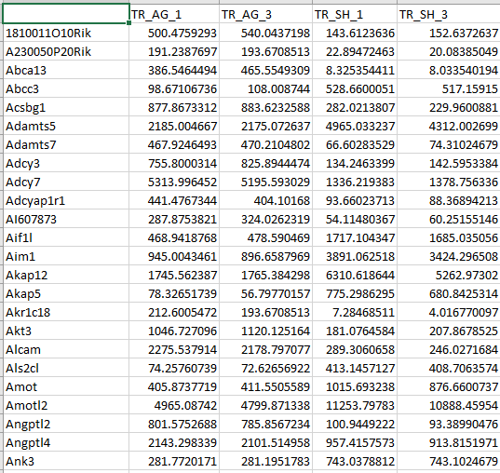
AG-SH DEG: AG group (AG1 and AG3) vs SH group (SH1, SH3) -- 330 DEGs

Slide 16
Mouse samples
Samples
SH (3 samples)
AG (3 samples)
Objectives
to find differentially expressed genes and pathways due to AG treatment in mouse cells
Analysis
PCA: to show SH samples and AG samples cluster in two distinct groups. If not, some samples may be eliminated in the following analyses.
DEG4 (p<0.01, log2FC>1 or <-1)
Heatmap using DEG4
Pathway analysis: to find what pathways may be upregulated/downregulated by AG treatment.

Slide 17
Analyses -- continued
Heatmap
用DEG3（234个基因）做K70，K70P10，K70MD，共8个标本
用DEG1/DEG2/DEG3 overlap的基因，做K70，K70P10，K70MD，共8个标本
Pathway analysis
DEG1做pathway analysis证明, P10 treatment downregulates NRF2 pathway and downregulates/upregulates some other pathways
DEG2做pathway analysis，证明MD treatment downregulates NRF2 pathway and downregulates/upregulates some other pathways
DEG3做pathway analysis，佐证这个list确实是NRF2 pathway（当然会包括一些其它通路，而且所谓NRF2 pathway是一大类，在数据库里会显示为很多不同名字的通路，比如redox regulation, response to oxidative stress, drug metabolism, …）

Slide 18
Outstanding requests
PCA of 4 mouse samples
PCA of 8 human samples
Upload normed data of 8 human samples (for GSA by Caizhi)

Slide 19
DEG list 2
2550 DEGs
447 DEGs
2016 DEGs
1727 DEGs

Slide 20
DEG list 1
421 DEGs
258 DEGs

Slide 21
DEG list 1
1990 DEGs

Slide 24
AKR1B10 AKR1C2 AKR1C3 COX5B DBI JTB NAA38 NT5C ODC1 OSGIN1 PGD PTDSS1 SLC7A11 TKT TMEM14A

Slide 25
Luke’s analysis on DEGs lists
Group 1
MDDEG: 1727 genes
P10DEG: 1990 genes
MDDEG-P10DEG overlap: 531 genes
Group 2
ESCCNRF2 gene: 234 genes
MDDEG-ESCCNRF2 overlap: 47 genes
P10DEG-ESCCNRF2 overlap: 43 genes
Group 3
NRF2 RNAseq (mouse esophagus): 1940 genes
With_human_homolog: 1557
MDDEG-RNAseq overlap: 184 (185)genes
P10DEG-RNAseq overlap: 209 genes

Slide 28
102 DEGs
220 DEGs
63 DEGs
125 DEGs

Slide 30
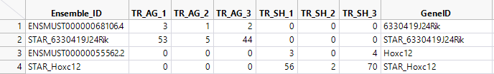

Slide 31
Fourth pass stops here

Slide 32
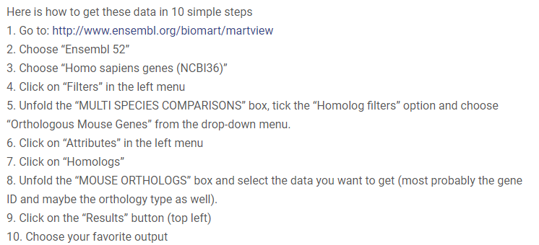
Get homologue from ensembl

Slide 33
1. Human samples
(1) MDDEG (1727 genes）做Pathway analysis：（a） 证明 NRF2 pathway significantly enriched？（b）发现其它significantly enriched pathways？
(2) P10DEG (1990 genes) 做Pathway analysis：（a） 证明 NRF2 pathway significantly enriched？（b）发现其它significantly enriched pathways？
(3) MDDEG-P10DEG overlap（531 genes）做Pathway analysis：发现MD和P10它们都能影响的significantly enriched pathways，借此说明它们作用机制上的相似之处？
(4) Use IPA or GSA for pathway analysis. Biologist-friendly pathway output (e.g., Wnt pathway, epidermal differentiation, drug metabolism) is preferred.
(5) MD作用在NRF2 pathway上的佐证：（a）MDDEG-ChIPseq overlap有185/1557 genes；（b）MDDEG-ESCCNRF2 overlap有47/234 genes。
(6) P10作用在NRF2 pathway上的佐证：（a）P10DEG-ChIPseq overlap有209/1557 genes；（b）P10DEG-ESCCNRF2 overlap有43/234 genes。
(7) 上传人RNAseq normalized data spreadsheet (all 9 samples), I will ask Caizhi to do GSA analysis using data of 8 samples (without P10_3).

Slide 34
2. Mouse samples
(1) AG-SH DEG: AG group (AG1 and AG3) vs SH group (SH1, SH2, SH3)
(2) Volcano plot: AG group (AG1 and AG3) vs SH group (SH1, SH2, SH3). adjusted p<0.01, log2FC>1<-1
(3) Heatmap with AG-SH DEG (adjusted p<0.01, log2FC>1<-1): AG1, AG3, SH1, SH2, SH3
(4) Pathway analysis with AG-SH DEG (adjusted p<0.01, log2FC>1<-1)
(5) 上传鼠RNAseq normalized data spreadsheet (all 6 samples), I will ask Caizhi to do GSA analysis using data of 6 samples or 5 samples (without AG2).

